Slide 1

KSRTC PENSION FORUM
MAR THOMA COLLEGE OF SCIENCE AND TECHNOLOGY
DEPARTMENT OF COMPUTER SCIENCE
Members
ARJUN A L(32020806013)
ARUN B S(32020806014)
ATHIL CHAND(3202080615)
JYOTHISH S L(32020806022)

Slide 2

1.Abstract
3.Menu Tree
2.Modules explanation
2.1 KSRTC Home Page
2.2 Pensioner Page
2.3 Stationmaster Page
2.4 Admin Page
2.5 Payment Page
3.Data Flow Diagrams
3.1 Level 0
3.2 level 1 Pensioner
3.3 level 1 Stationmaster
3.4 level 1 Admin
4.Table List
Index

Slide 3
ABSTRACT
K.S.R.T.C PENSION FORUM is primarily social welfare programme of the Government of Kerala. The Kerala State Road Transport Corporation (KSRTC) is struggling to mobilise Rs.113 crore to clear the pension of 37,000 retirees The State transport utility could not mobilise Rs.300 crore from the District Cooperative Bank as planned. Also, revenue from the fleet operations did not match expectations. Sources in KSRTC told that objections had been raised by the Registrar of Cooperatives to the corporation taking loan from the bank. The Registrar has sought report on the repayment capacity of the KSRTC, apart from steps to clear a guarantee commission of Rs.8 crore to be paid to the District Cooperative Bank. In this System manages the pension calculation of a retired person who register into the system.The calculation is based on the basis of the year and month of he retired. KSRTC Pension Forum has include 4 Modules.

Slide 4
MODULES
1. Administrator Module
• Manage news updates
• Compose messages
• View Inbox
• View send messages
• View Feedback
2. Station Master Module
• View pensioners request
• View application
• Manage Pension
• Compose Message
• View Inbox
• View Send Message

Slide 5
3. Pensioner Module
• Registration
• View all details
• View pension status
• Compose message
• View send message
• View Inbox
4. Payment
• Automatic Pension Calculation (admin)
• Notification Loading (pensioner)
• Payment passing (admin)
• Document verification (admin)
• Accounts checking (pensioner)
• Retirement Amount calculation (automatic)

Slide 6

Menu Tree

Slide 7

KSRTC HOME PAGE
KSRTC Home is the opening page of our project .It holds…
About Us Page: Holding the history of KSRTC.
Contact page : Holding the numbers and address of the all KSRTC Depos.
Login Page
Signup for
Stationmaster
Pensioner
DFD Level 0

Slide 8

STATION MASTER PAGE
Contents
Stationmaster profile registration
News Viewing: News released or updated by admin can be viewed by every stationmasters
Pension application view: Here the pension application can be viewed and approved by stationmasters
Message
1.Pension Inbox: Here the messages from the pensioners are stored and viewed
2.View Send Message: Here the stationmasters can provide replay to their corresponding pensioners on the basics of their depos.
3.Compose Admin Messages: Here the messages to the admin are composed.
Data Flow Diagram
Data tables
DFD

Slide 9

PENSION PAGE
Pension Profile View: Here pensioners can view their profile.
News View : News from the admin can be viewed by pensioners.
Pension Apply: Here user can complete the pension registration processes.
Pension Apply View: Here pensioners can view their applied form.
Pension Feedback: Here pensioners can ask feedback about pension registration
Pension feedback viewing: Here we can view feedback.
Notifications: Here notifications of credited pensions are viewed.
Sending message to stationmaster: Here messages regarding pension related issue can be send.
Viewing messages which are send to Stationmaster: Here we can view messages we have send to stationmaster
View Messages: Here messages from the stationmasters are viewed.
Complaint sending : This section allows pensioners to send complaint to stationmasters.
Complaint view : Here submitted complaint can view.
DFD

Slide 10
ADMIN PAGE
Admin home page holds the data of total Pensioners, Stationmasters, Messages and list of subpages listed on context.
Context
Message Inbox: Message from the Station masters are visible on inbox with replay button redirecting to
admin stationmaster message replay page.
News:
1.News Send : News for stationmasters and pensioners are uploaded from here.
3.News View: Here uploaded news can be viewed and edited.
Stationmasters : Here registered stationmasters are approved or rejected.
Pension : Here registered pensioners are approved or rejected.
Pension Complaint: Here pension complaint can be viewed.
Pension Feedback: Here pensioner feedbacks of pension related issue can be viewed.
Stationmaster approved pensioners :Here pensioners who are approved by stationmaster can be
viewed for further approval.
Pension approval list: Here it holds the final list of pensioners who are eligible for pension payment.
DFD

Slide 11
PAYMENT PAGE
In payment page automatic pension calculation and retirement amount calculation are done. Notifications for each payment for the pensioners are notified with an messange on their pages.

Slide 12
1. login
Description: Used to store username and password of users
Column | Datatype | Size | Constraints | Description
loginid | int | 11 | Primary Key | Store Login Id
Email | varchar | 10 | Not Null | Store User’s Email id
Password | varchar | 32 | Not Null | Store User’s Password
Usertype | enum | ‘0’,’1’,’2’,’3’ | Not Null | Store User Type
Status | enum | ‘0’,’1’,’2’ | Not Null | Store Login Status

Slide 13
2.userreg(station master registration)
Description: Used to store Stationmaster details
Column | Datatype | Size | Constraints | Description
Userid | int | 11 | Primary Key | Store Stationmaster Id
Name | varchar | 15 | Not Null | Store Stationmaster’s Name
Address | varchar | 50 | Not Null | Store Stationmaster’s Address
Pincode | varchar | 6 | Not Null | Store Stationmaster’s Pincode
District | varchar | 20 | Not Null | Store Stationmaster’s District
Gender | varchar | 6 | Not Null | Store Stationmaster’s Gender
DOB | Date |  | Not Null | Store Stationmaster’s DOB
Depo | varchar | 20 | Not Null | Store Stationmaster’s Department
Contactno | varchar | 13 | Not Null | Store Stationmaster’s Contact
Loginid | int | 11 | Foreign Key | Store Stationmaster’s Login Id

Slide 14
3.pension
Description: Used to store Pensioner details
Column | Datatype | Size | Constraints | Description
pensionid | int | 10 | Primary Key | Store Pensioner Id
Name | varchar | 15 | Not Null | Store Pensioner Name
Address | varchar | 50 | Not Null | Store Pensioner Address
Pincode | varchar | 6 | Not Null | Store Pensioner Pincode
District | varchar | 20 | Not Null | Store Pensioner District
Gender | varchar | 6 | Not Null | Store Pensioner Gender
Depo | varchar | 20 | Not Null | Store Pensioner Depo
DOB | date |  | Not Null | Store Pensioner DOB
Retirementdate | date |  | Not Null | Store Pensioner Retirement date
Adharno | varchar | 12 | Not Null | Store Pensioner Adhar number
Contactno | varchar | 12 | Not Null | Store Pensioner Contact number
Photo | text |  | Not Null | Store Pensioner Photo
loginid | int | 11 | Foreign Key | Store Pensioner Login id

Slide 15
4.pensionapply
Description: Used to store Pension Applied details
Column | Datatype | Size | Constraints | Description
pensionapplyid | int | 10 | Primary Key | Store pension Application Id
fathername | varchar | 15 | Not Null | Store Pensioner Name
mothername | varchar | 15 | Not Null | Store Pensioner Address
marital | varchar | 8 | Not Null | Store Pensioner District
nationality | varchar | 15 | Not Null | Store Pensioner Gender
state | varchar | 20 | Not Null | Store Pensioner Contact
religion | varchar | 50 | Not Null | Store Pensioner Religion
category | varchar | 50 | Not Null | Store Pensioner Category
pass_status | enum | ‘0’,’1’ | Not Null | Store Pension Pass Status
status | enum | ‘0’,’1’,’2’ | Not Null | Store Pension Approved Status
Loginid | int | 11 | Foreign Key | Store Pensioner Login Id

Slide 16
5. complaint
Description: Used to Store Complaints
Column | Datatype | Size | Constraints | Description
complaintid | int | 10 | Primary Key | Store complaint Id
Subject | varchar | 1000 | Not Null | Store Complaint Subject
complaint | varchar | 1000 | Not Null | Store Complaints
currentdate | date |  | Not Null | Store Complaint Date
loginid | int | 11 | Foreign Key | Store Complaint login id
6. feedback
Description: Used to store Feedback Details
Column | Datatype | Size | Constraints | Description
feedbackid | int | 10 | Primary Key | Store feedback Id
feedback | varchar | 500 | Not Null | Store feedback description
date | date |  | Not Null | Store feedback date
loginid | int | 11 | Foreign Key | Store feedback login id

Slide 17
7. bank
Description: Used to store Bank Holders Details
Column | Datatype | Size | Constraints | Description
bankid | int | 11 | Primary Key | Store Bank Id
bankname | varchar | 100 | Not Null | Store Bank Name
branchname | varchar | 100 | Not Null | Store Branch Name
ifsc | varchar | 10 | Not Null | Store IFSC Code
accholname | varchar | 100 | Not Null | Store Account Holders Name
accno | varchar | 100 | Not Null | Store Account Number
cardno | varchar | 100 | Not Null | Store Card Number
cvv | varchar | 3 | Not Null | Store CVV Code
expirydate | varchar |  | Not Null | Store Expiry Date
contactno | varchar | 12 | Not Null | Store Contact Number
tamount | varchar | 100 | Not Null | Store Total Amount

Slide 18
8. payment
Description: Used to store Payment Transaction
Column | Datatype | Size | Constraints | Description
paymentid | int | 11 | Primary Key | Store Payment Id
name | varchar | 15 | Not Null | Store Card Name
cardno | varchar | 16 | Not Null | Store Card Number
cvv | varchar | 3 | Not Null | Store CVV Code
expirydate | varchar | 10 | Not Null | Store card Expiry Date
amount | varchar | 10 | Not Null | Store amount
loginid | varchar | 11 | Foreign Key | Store Payment login id
currentdate | date |  | Not Null | Store Payment date
payment | enum | ‘0’,’1’ | Not Null | Store Payment status
contactno | varchar | 15 | Not Null | Store Payer contactno

Slide 19
9. news
Description: Used to store news details
Column | Datatype | Size | Constraints | Description
newsid | int | 11 | Primary Key | Store news Id
title | varchar | 50 | Not Null | Store news title
report | varchar | 50 | Not Null | Store news report
date | date |  | Not Null | Store news date
10. message
Description: Used to store message details
Column | Datatype | Size | Constraints | Description
messageid | int | 11 | Primary Key | Store Message Id
msg | varchar | 500 | Not Null | Store Message
date | date |  | Not Null | Store Message Date
time | time |  | Not Null | Store Message Time
senderid | int | 10 | Not Null | Store Sender Login Id
receiverid | int | 11 | Not Null | Store Receiver Login Id
viewstatus | enum | ‘0’,’1’ | Not Null | Store Message View Status
usertype | enum | ‘0’,’1’,’2’ | Not Null | Store Sender Usertype

Slide 20
Drawback
1.Live chat system.
2.No 24*7 contact support.
3.Offline messaging system is not available.
4.No two step authentications.

Slide 21
Future Enhancement
1.Live chat system.
2. 24*7 contact support.
3.Enabling 0ffline messaging system .
4.Providing health insurance for pensioners through online

Slide 22
THANK YOU

Slide 23
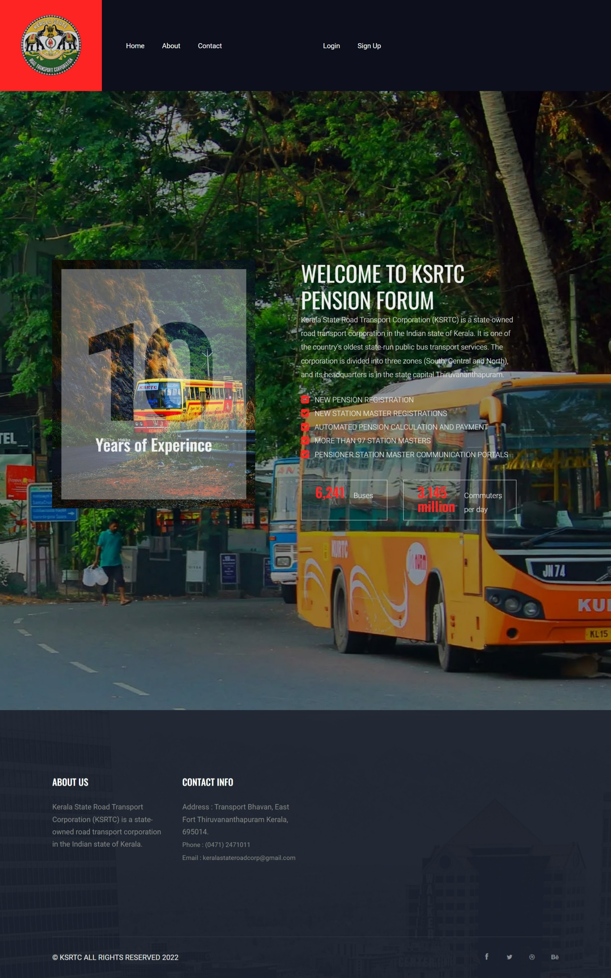


Slide 24
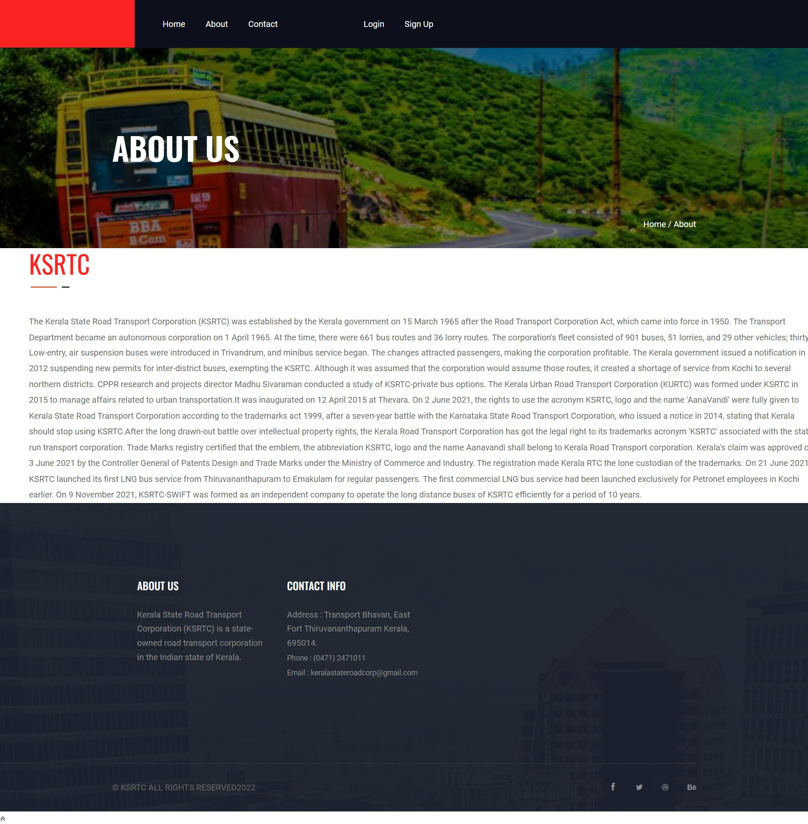

Slide 25
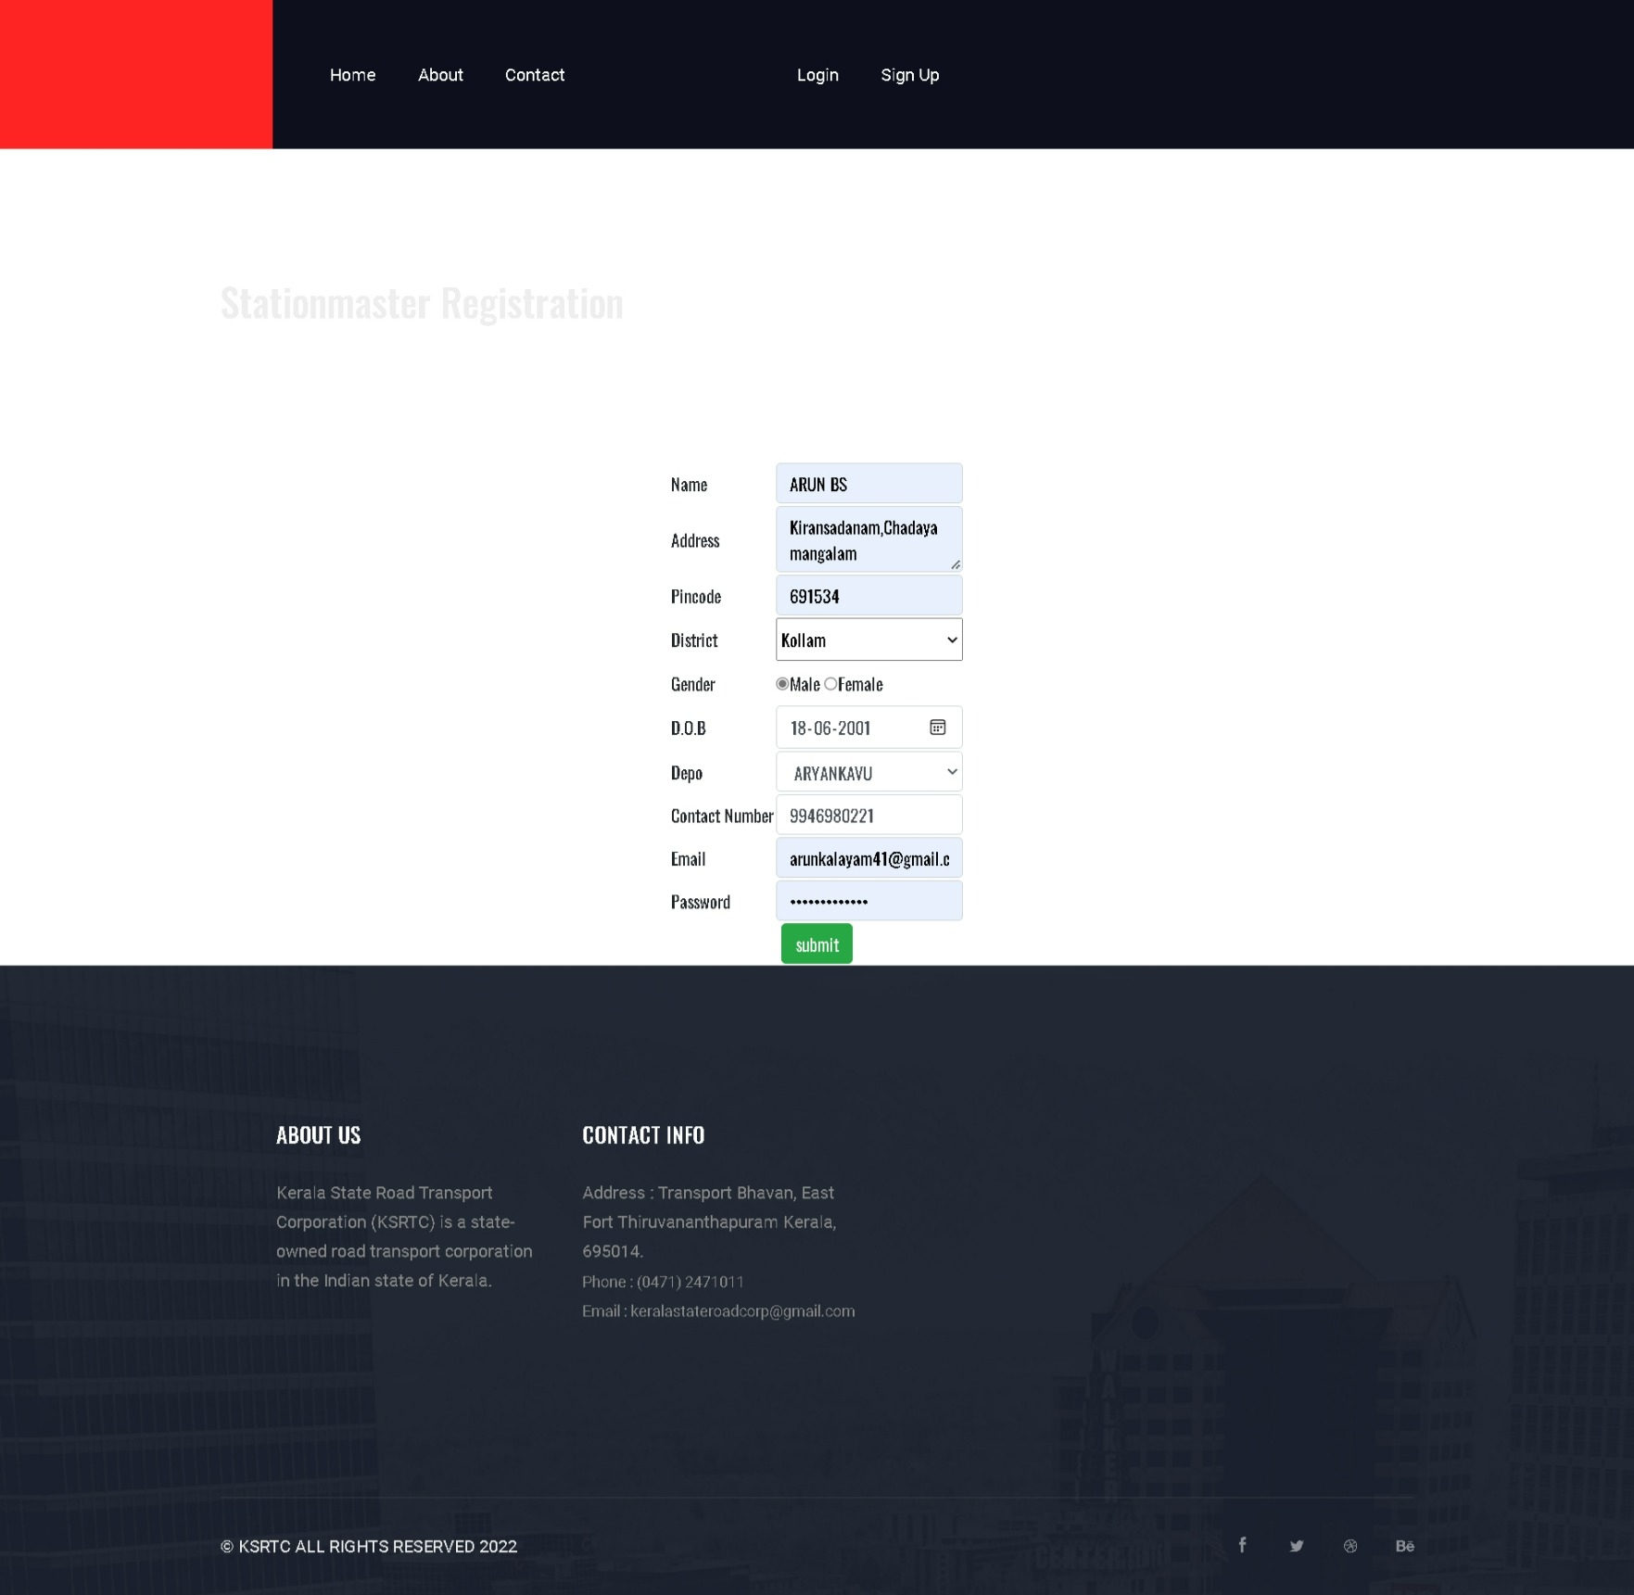
Here the procedure for the Stationmaster are done. Here stationmasters can register with their personal information’s with their contact number and depos respectively. The email and password generated here is used for further login purposes

Slide 26
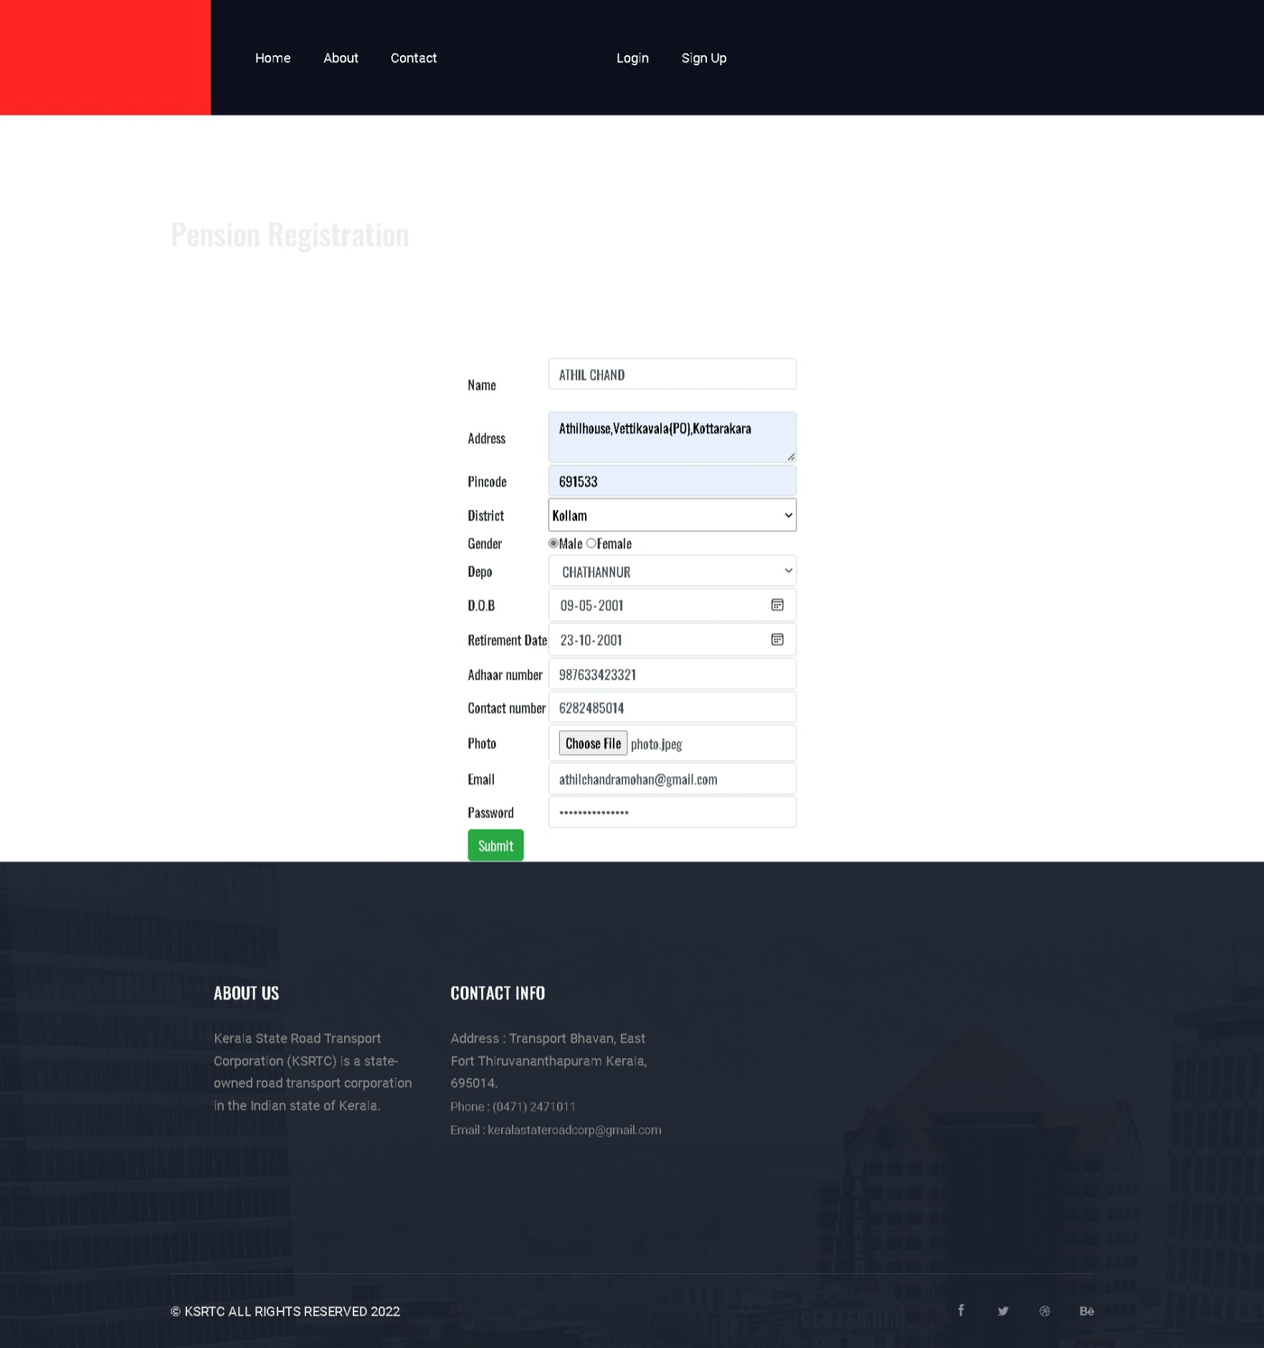
Here the procedure for the Pension registration are done. Here pensioners can register with their personal information’s with their contact number and depos respectively. The email and password generated here is used for further login purposes

Slide 27


Slide 28
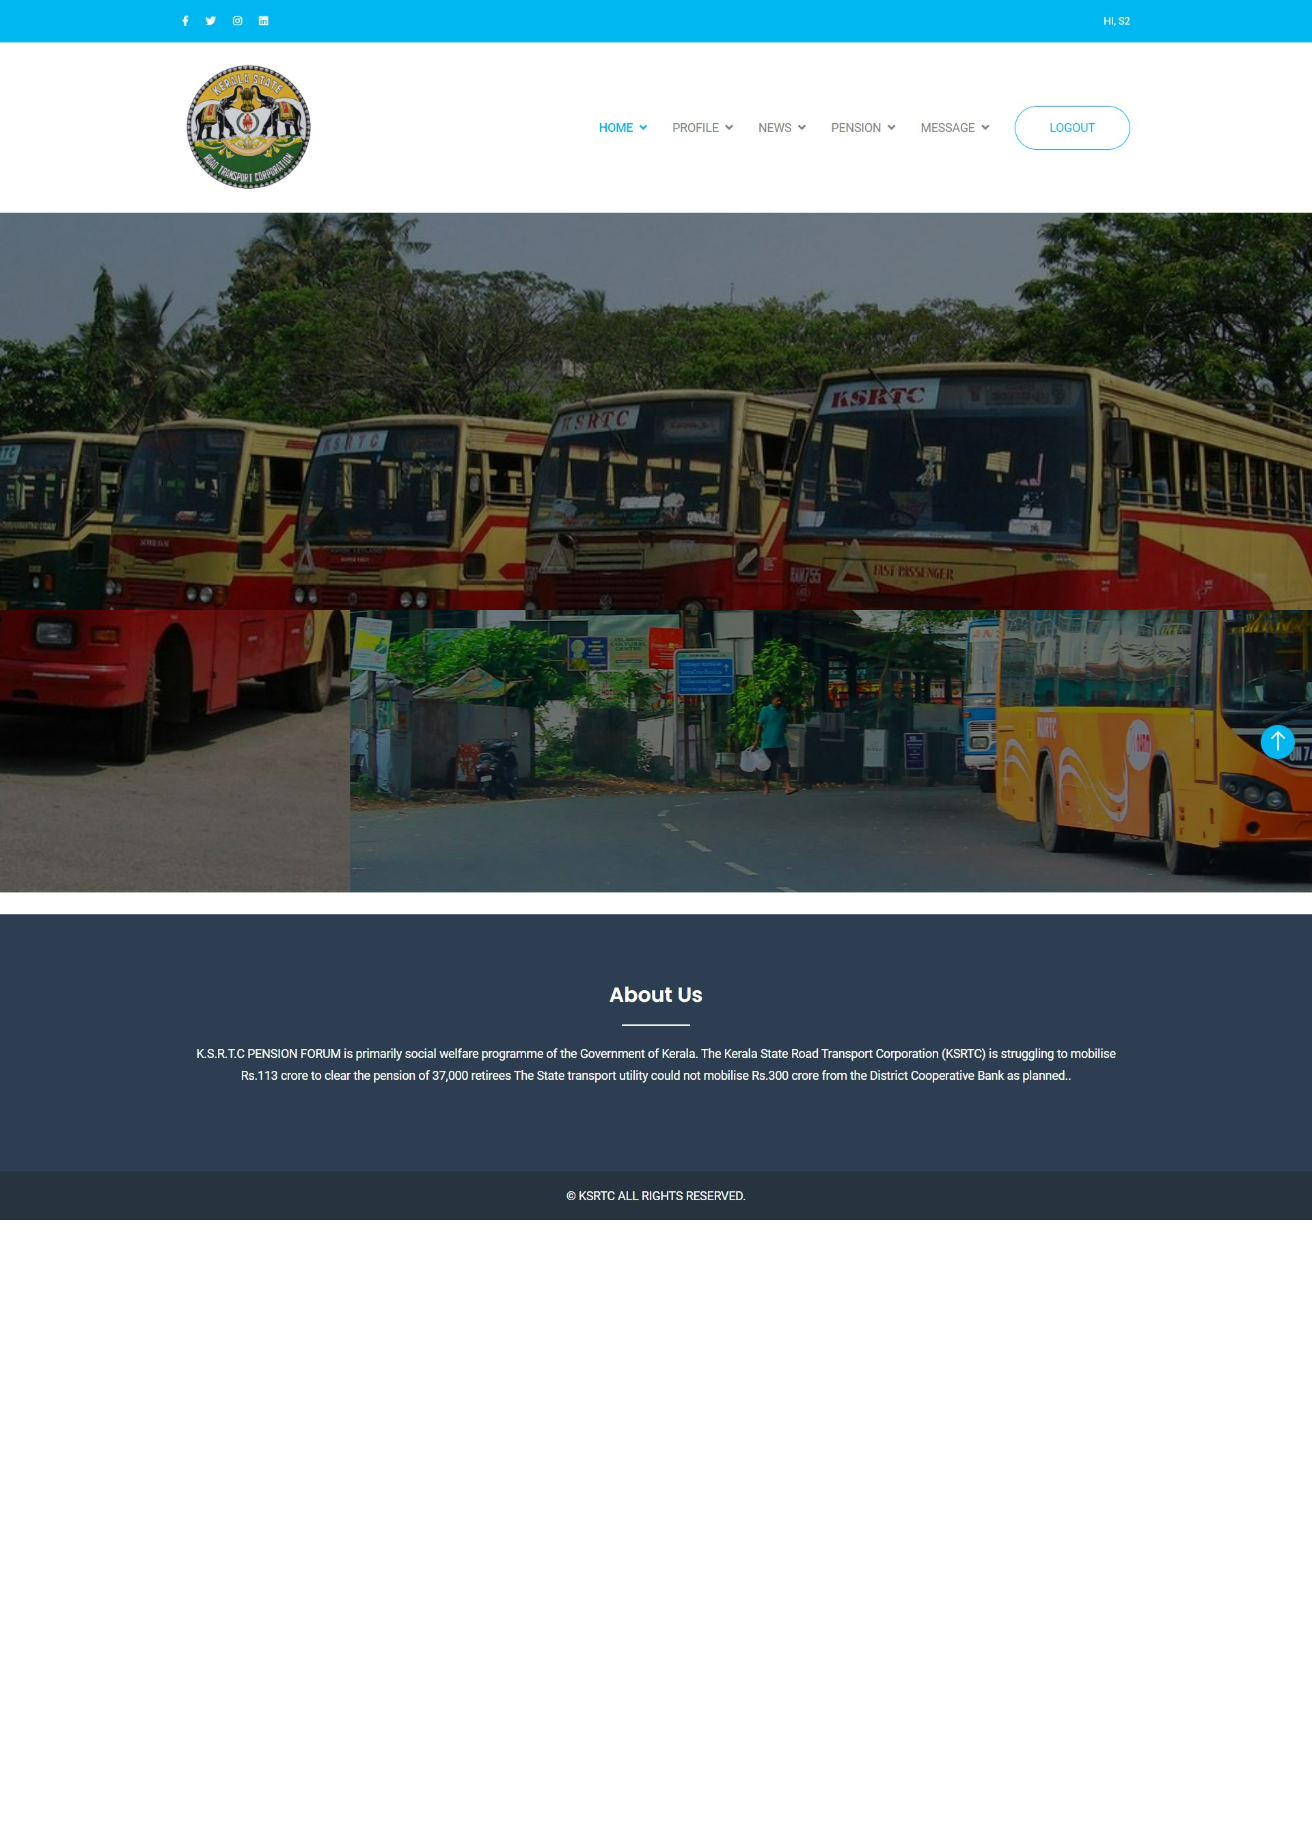

Slide 29
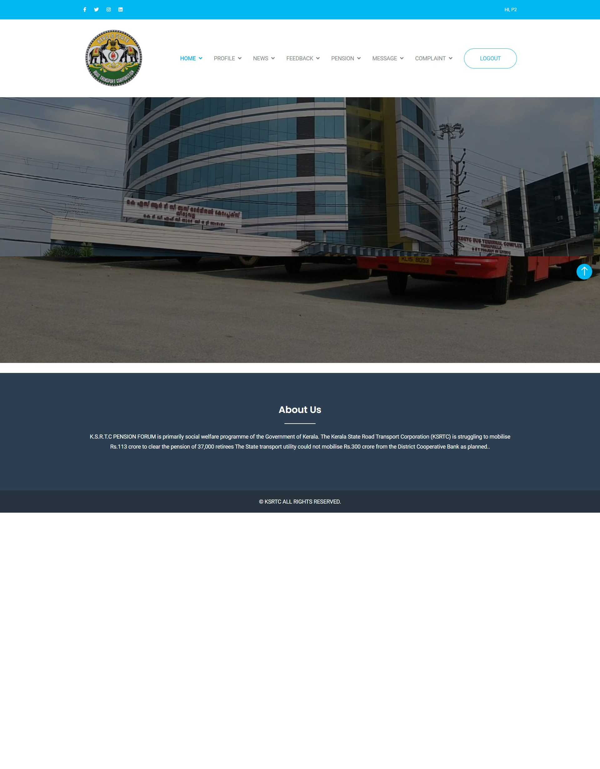

Slide 30
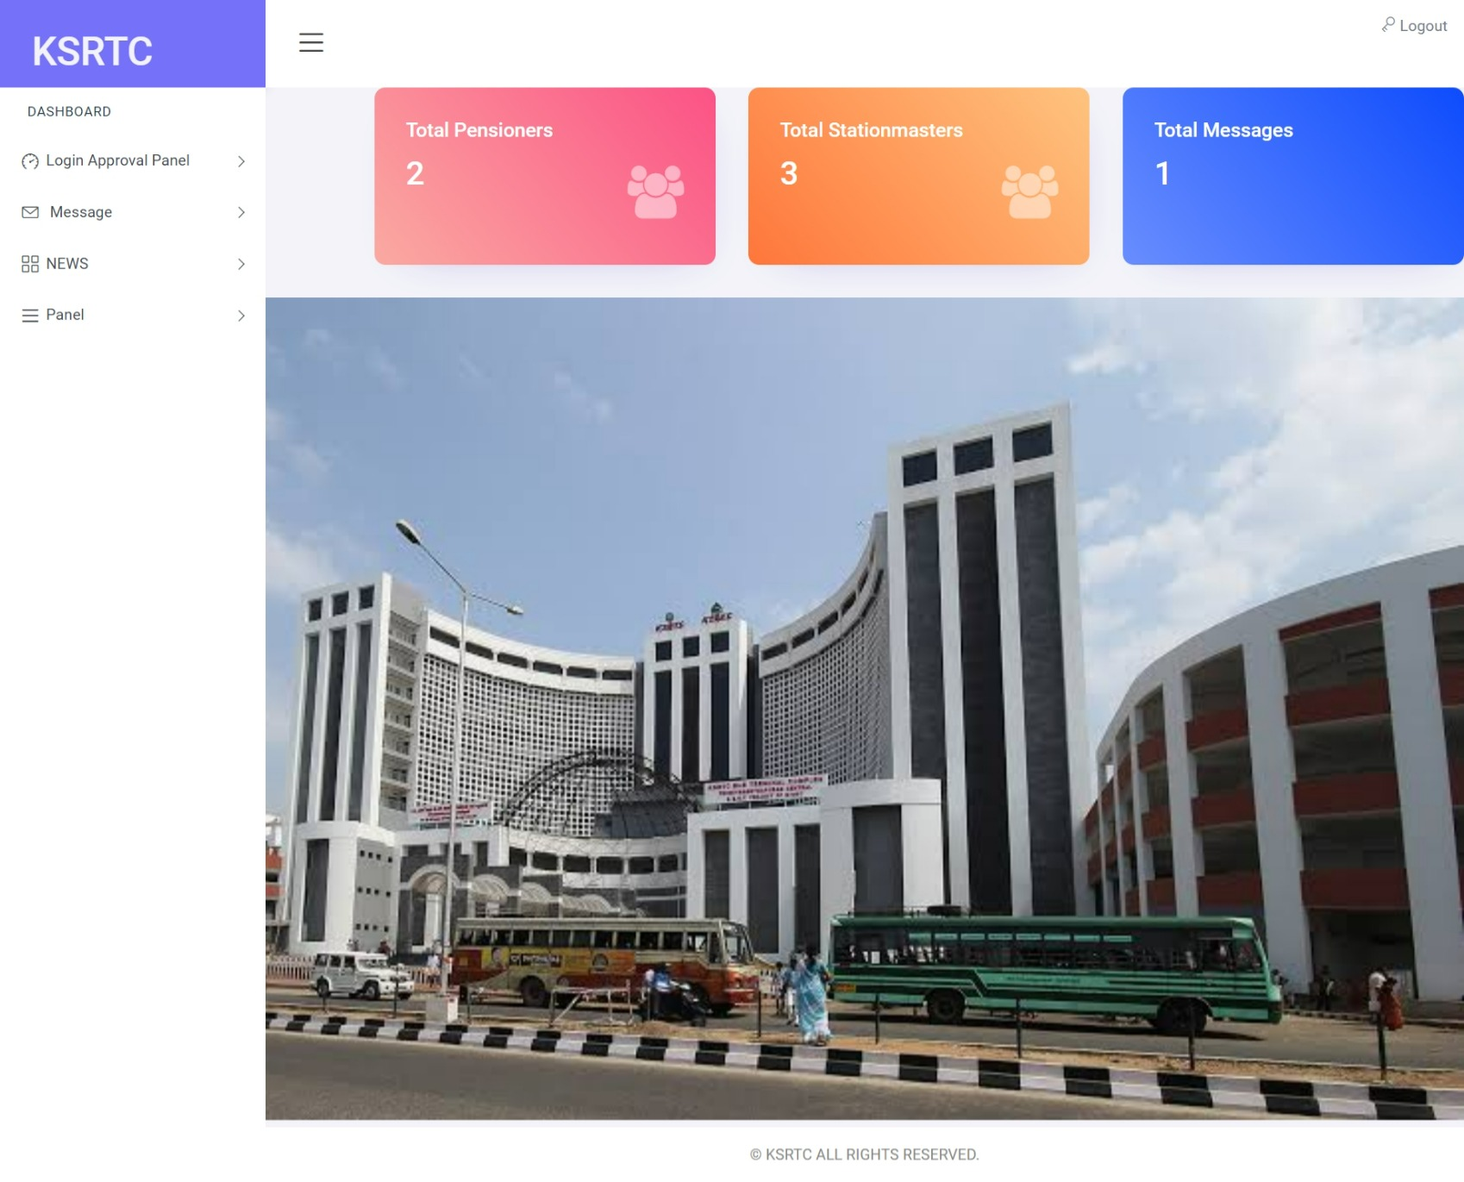

Slide 31
